Slide 1
Spectral clustering

Slide 2
Main difference from k-means
There are 2 broad approaches for clustering: 1. Compactness — Points that lie close to each other fall in the same cluster and are compact around the cluster center. The closeness can be measured by the distance between the observations. E.g.: K-Means Clustering 2. Connectivity — Points that are connected or immediately next to each other are put in the same cluster. Even if the distance between 2 points is less, if they are not connected, they are not clustered together. Spectral clustering is a technique that follows this approach.

Slide 3
Clustering steps
Spectral clustering involves 3 steps:
Compute a similarity graph
Project the data onto a low-dimensional space
Create clusters

Slide 4
Step 1. Similarity graph
Ways to compute:
The ε-neighborhood graph
KNN Graph
Fully connected graph
This can be represented by an adjacency matrix which has the similarity between each vertex as its elements .

Slide 5
Step 2. Laplacian
Our goal then is to transform the space so that when the 2 points are close, they are always in same cluster, and when they are far apart, they are in different clusters. We need to project our observations into a low-dimensional space. For this, we compute the Graph Laplacian, which is just another matrix representation of a graph and can be useful in finding interesting properties of a graph.

Slide 6
Laplacian
The whole purpose of computing the Graph Laplacian was to find eigenvalues and eigenvectors for it, in order to embed the data points into a low-dimensional space. So now, we can go ahead and find eigenvalues.

Slide 7
Step 3. Create clusters
For this step, we use the eigenvector corresponding to the 2nd eigenvalue to assign values to each node. We then split the nodes such that all nodes with value > 0 are in one cluster, and all other nodes are in the other cluster.
It is important to note that the 2nd eigenvalue indicates how tightly connected the nodes are in the graph. For good, clean partitioning, lower the 2nd eigenvalue, better the clusters.

Slide 8
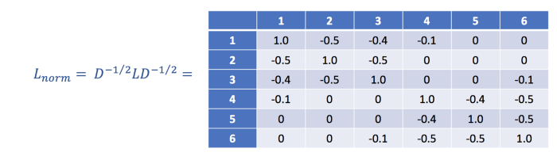
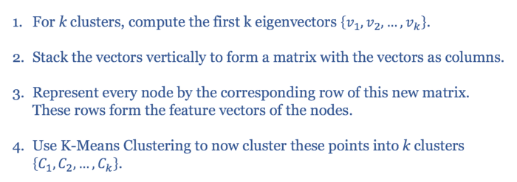
Step 3. For k clusters
For k clusters, we have to modify our Laplacian to normalize it.

